Slide 1

Developing Full Stack Solutions with C# and ASP.NET Core 3.0
Scott Dockendorf
Chief Technology Officer, Remote Operations
SEPTEmber 11, 2019
NORTH DALLAS DEVELOPERS Group

Slide 2

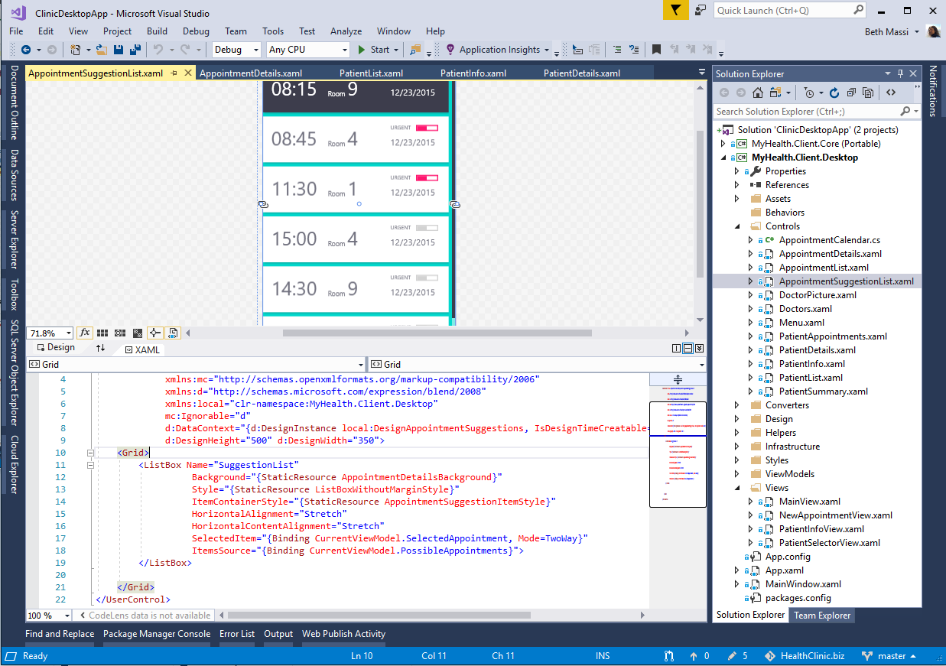
ANNOUNCING
.NET Core 3.0 Preview 9 (September 4th)
Windows desktop support with WPF and WinForms, also open source
Flexible deployment, side-by-side support and self-contained EXEs
New C# language features for productivity and less errors
IoT (https://github.com/dotnet/iot) & AI via ML.NET (https://bit.ly/2HOvxSU)
Performance improvements
Full-stack web development with C# and Razor
Now includes Go-Live license
Notes:
Go-Live is supported by Microsoft in production. Be brave, but remember that there are possible breaking changes in Preview 8 & 9 from EF and Blazor.

Slide 3



.NET Core 3.0: A full stack solution
Client
Frontend
Backend
http://..
ASP.NET Core
Worker
API
Blazor
Components
SPA (JavaScript)
MVC / Razor Pages
Web APIs
SignalR
Security & identity
Worker Services
gRPC API

Slide 4

Demo Logical Architecture
?
API

Slide 5
New .NET Core 3.0 Features
http://..
API
API
Worker
Service

Slide 6
Let’s start with Blazor
http://..
API
API
Worker
Service

Slide 7

Blazor
Build client-side web UI with .NET instead of JavaScript
Call into JavaScript libraries & browser APIs as needed
Write reusable web UI components with C# and Razor
Share .NET code with both the client and the server
Blazor for WebAssembly now in official preview!

Slide 8



Blazor on client or server
Client-side
Server-side
https://...
https...
ASP.NET Core
Razor Components
DOM
SignalR
DOM
.NET
WebAssembly
Razor Components
.NET
Will ship in a future release
Will ship with .NET Core 3.0

Slide 9
Blazor Approach Comparison
 | Client-Side | Server-side
Pros | Can run offline Faster execution (within browser) Debugging? https://bit.ly/2OMUiz0 | Startup timing is faster. Supports full debugging Supports every .NET API and library which runs with ASP.NET Core. Works also with old browsers that don’t support WebAssembly, like Internet Explorer
Cons | Longer startup timings (load .NET Framework & Assemblies) | Does NOT run offline Slower execution due to required constant connection with the server

Slide 10

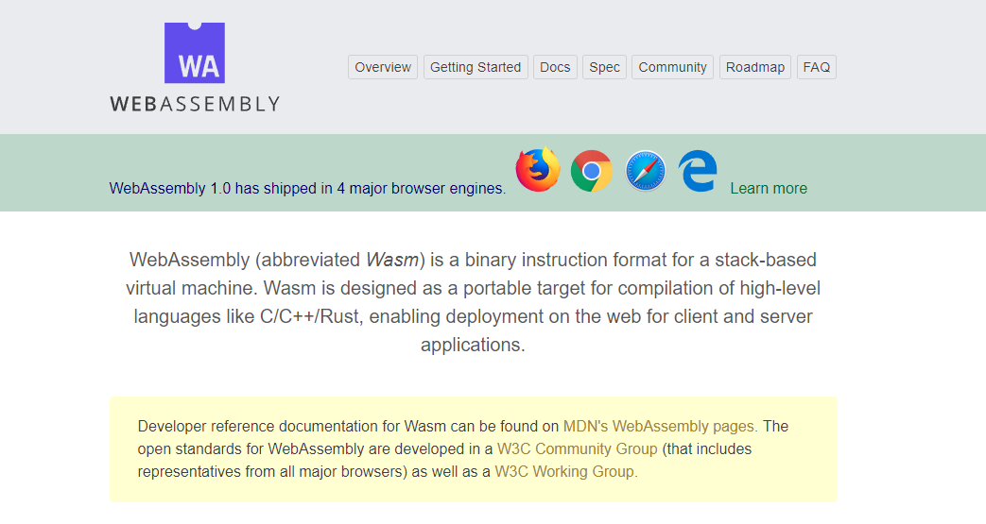
WebAssembly.org
Documentation: https://webassembly.org/docs/high-level-goals/

Slide 11






WebAssembly Working Group https://bit.ly/32yDOCP
Members from industry leaders:

Slide 12
WebAssembly Compatibility
Source: https://caniuse.com/#search=wasm

Slide 13

How WebAssembly Works
.NET Standard 2.0 Build
Delivered to browser
WASM alongside JS/HTML/CSS
MyBlazorClient.dll
MyBlazorClient.dll
JS
mono.wasm + Supporting files
mono.wasm + Supporting files
Referenced Assemblies
Referenced Assemblies
Referenced Assemblies
Referenced Assemblies
HTML
CSS
Referenced Assemblies
Referenced Assemblies

Slide 14
Machine Configuration To Run Blazor (as of 9/11/2019)
Install Visual Studio 2019 v16.2 Preview 3 https://visualstudio.microsoft.com/vs/preview/
Install .net Core 3.0 SDK Preview 9 https://dotnet.microsoft.com/download/dotnet-core/3.0
Install Blazor Preview 9 https://marketplace.visualstudio.com/items?itemName=aspnet.blazor
Install Blazor Templates (Command-line) dotnet new -i Microsoft.AspNetCore.Blazor.Templates::3.0.0-preview9.19424.4
Blazor Reference –
https://docs.microsoft.com/en-us/aspnet/core/blazor/get-started?view=aspnetcore-3.0&tabs=visual-studio
https://devblogs.microsoft.com/aspnet/asp-net-core-and-blazor-updates-in-net-core-3-0-preview-9/

Slide 15
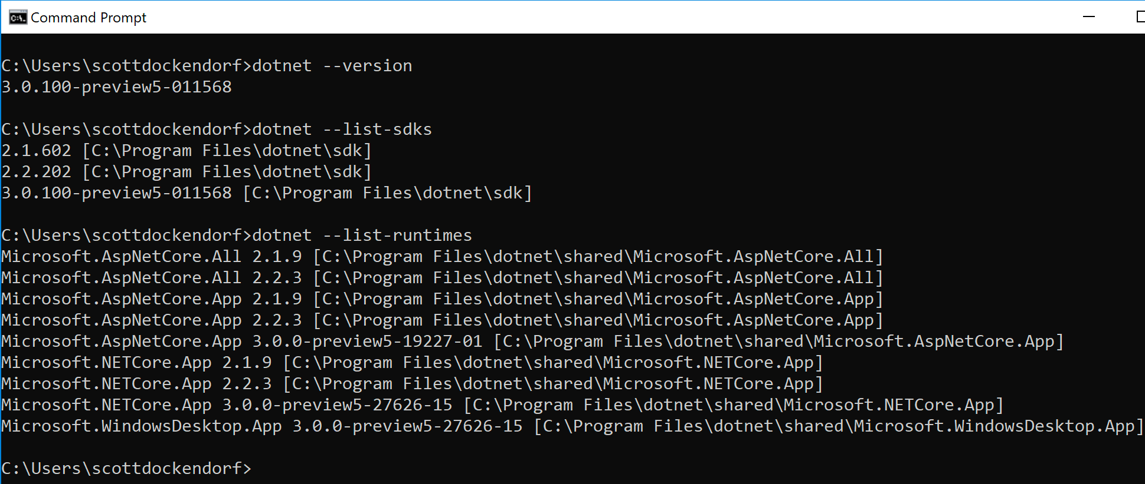
Confirm SDK Installation
dotnet -–version dotnet -–list–sdks dotnet -–list-runtimes

Slide 16
Demo
EXPLORE CLIENT-SIDE Blazor TEMPLATE

Slide 17
Worker Services
http://..
API
API
Worker
Service

Slide 18
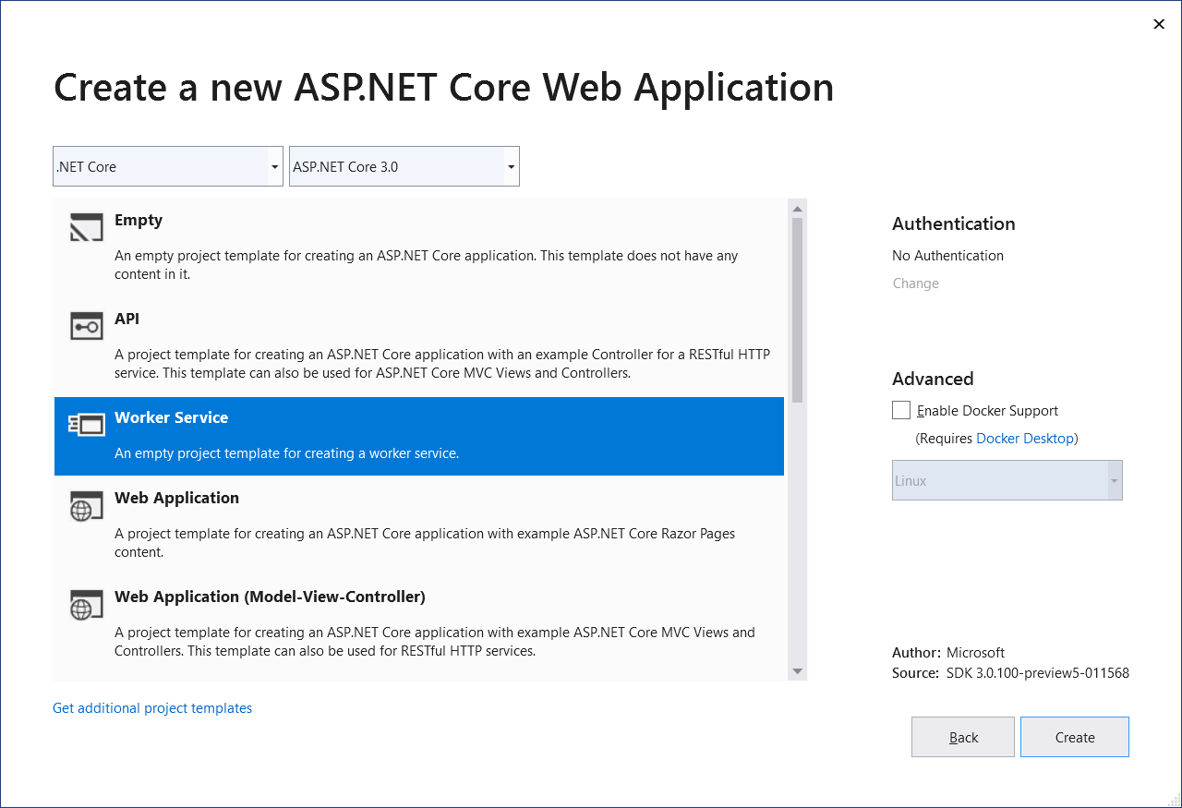
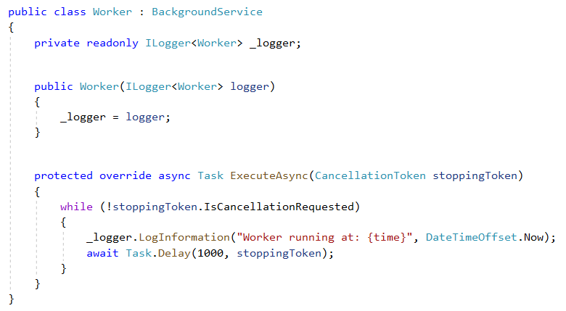
Worker services
.net Core 3.0 provides a new Worker Service template to build long-running worker processes
Integrates with .net core services such as configuration, logging, dependency injection
Host as Windows service, Linux systemd, Azure WebJobs, Docker containers

Slide 19
Demo
EXPLORE Worker service TEMPLATE

Slide 20




Web API Design Styles
A stateless architecture for data transfer that is dependent on hypermedia.
REST can tie together a wide range of resources that might be requested in a variety of formats for different purposes.
REST is fundamentally concerned with stateless resource management, so it’s best used in such situations.
Systems requiring rapid iteration and standardized HTTP verbiage will find REST best suited for their purposes.
An approach wherein the user defines the expected data and format of that data.
GraphQL is from Facebook, and that pedigree demonstrates its use case well — situations in which the requester needs the data in a specific format for a specific use.
In those cases, those data formats and the relations between them are vitally important, and no other solution provides the same level of interconnected provision of data.
Data updates to be served automatically, rather than requested.
Finally, Webhooks are best used when the API in question primarily updates clients.
While such APIs can also have other functions, even RESTful ones, the primary use of a Webhook microservice should be to update clients and provide updated, provisioned data upon the creation of the new, updated resource.
A contract-first interface-driven, nimble and lightweight system for requesting data.
gRPC, on the other hand, is best used when a system requires a set amount of data or processing routinely, and in which the requester is either low power or resource-jealous.
Examples: IoT, mobile, microservices
Source: https://nordicapis.com/when-to-use-what-rest-graphql-webhooks-grpc/

Slide 21
gRPC
http://..
API
API
Worker
Service

Slide 22

What is gRPC
gRPC is
modern open source high performance RPC framework that can run in any environment
efficiently connect services in and across data centers with pluggable support for load balancing, tracing, health checking and authentication
applicable in last mile of distributed computing to connect devices, mobile applications and browsers to backend services
USE CASES
Efficiently connecting polyglot services in microservices style architecture
Connecting mobile devices, browser clients to backend services
Generating efficient client libraries
Source: https://grpc.io/about

Slide 23
gRPC Important Concepts
Interoperability: Client libraries in 10 languages C#, C/C++, Dart, Go, Java, Node.js, PHP, Python, Ruby
Protobuf (aka “Protocol buffers”) as interface design language
Highly efficient on wire and with a simple service definition framework
Bi-directional streaming with http/2 based transport (Kestrel)
Pluggable auth, tracing, load balancing and health checking
Source: https://grpc.io/about

Slide 24
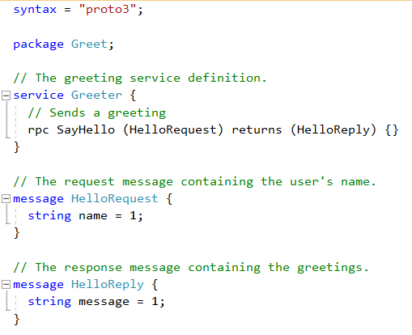
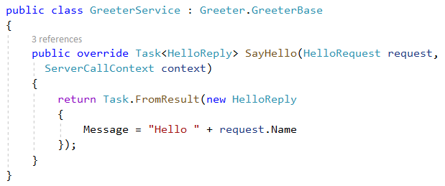
Protobuf ---> C#
gRPC Protobuf
C# Class

Slide 25
Demo: Order Management App
http://..
API
API
Worker
Service

Slide 26
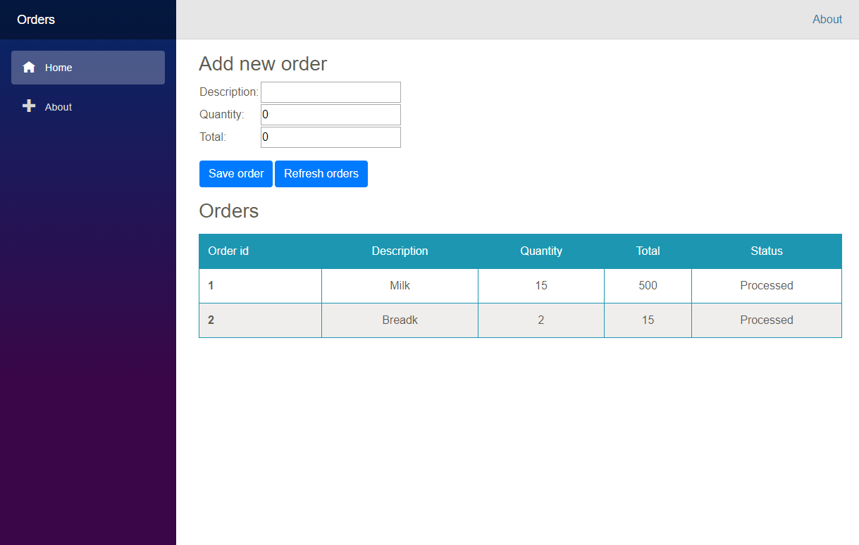
Let’s build an order management app!

Slide 27
Demo
The full architecture

Slide 28
Also new in ASP.NET Core 3.0
Blazor (server-side)
gRPC
Worker
Simplified shared framework
IdentityServer
API code generation
Endpoint routing integration
C# 8 in Razor & MVC
JSON
Windows service support
SignalR auto-reconnect, streaming
SignalR C++ client*
Event counters*
Certificate & Kerberos authentication*
Performance
*Coming soon!

Slide 29
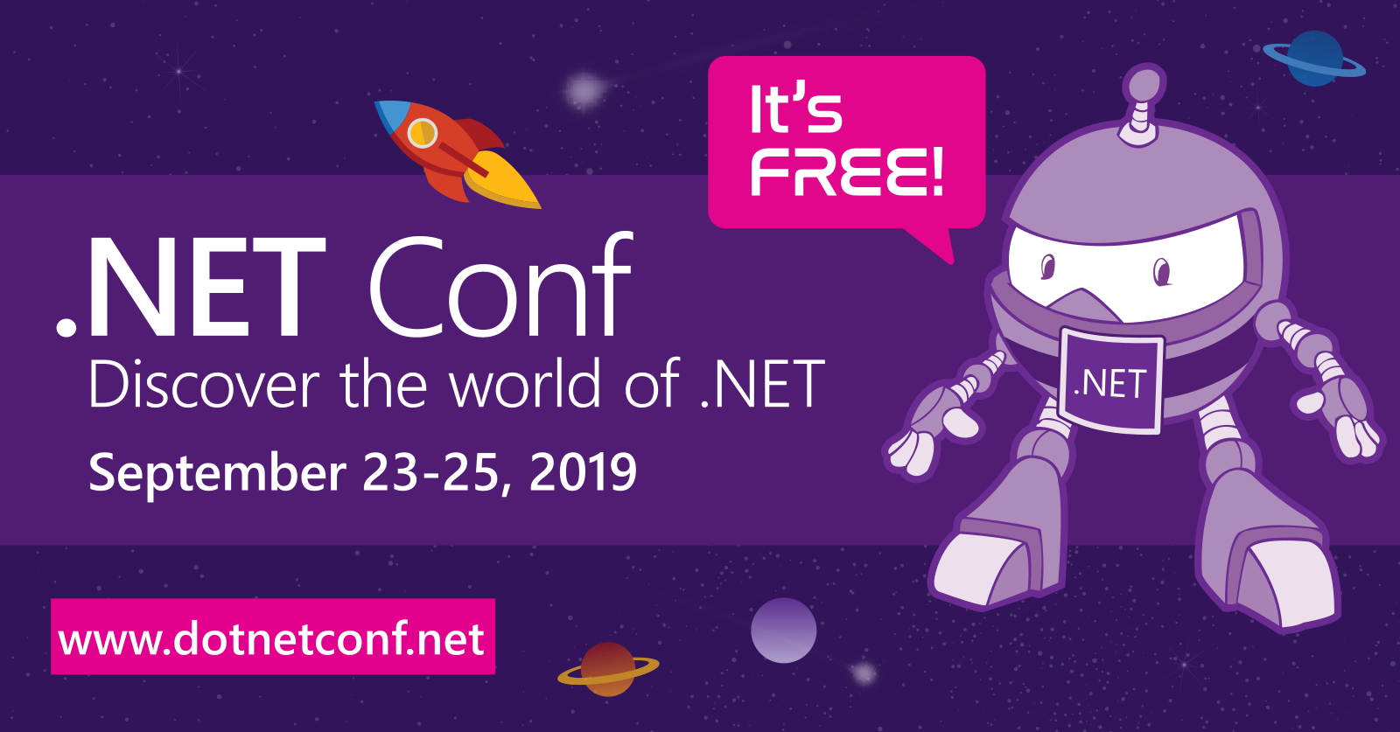
Local Event
Virtual Event
https://bit.ly/2m59bDX
https://www.dotnetconf.net
Monday Sept 23, 2019
11:00am – 5:00pm
Improving 5445 Legacy Drive #100
Plano, TX 75024
Sept 23 - 25, 2019
All day

Slide 30

.net Core 3.0 Launches at .NET CONF 2019
Local Event
Virtual Event
https://bit.ly/2m59bDX
https://www.dotnetconf.net
Monday Sept 23, 2019
11:00am – 5:00pm
Improving 5445 Legacy Drive #100
Plano, TX 75024
Sept 23 - 25, 2019
All day

Slide 31
References
http://..
Worker
Service
Blazor https://bit.ly/2xJbcIK
Blazor Components https://bit.ly/2LSJrWy
TONS OF BLAZOR RESOURCES https://bit.ly/2K9opyd
Blazor Workshop https://bit.ly/2LUJD7n
gRPC https://grpc.io/
gRPC Quickstart C# https://bit.ly/2LReCkX
When to use gRPC, Webhooks, REST, GraphQL https://bit.ly/2Axjzc0
Worker services https://bit.ly/2XVrZa2
Notes:
Informative links for your review

Slide 32
References
Core Documentation https://aka.ms/dotnet-docs
SDK Documentation https://aka.ms/dotnet-cli-docs
Release Notes https://aka.ms/netcore3releasenotes
Tutorials https://aka.ms/dotnet-tutorials
Introduction https://bit.ly/2XJPH9S
Migrate from ASP.NET to ASP.NET Core https://bit.ly/2ShOKz4
Migrate from 2.2 to 3.0 https://bit.ly/2JU8c1Z
What’s New - https://bit.ly/2JGkIC1
Identity - https://bit.ly/2E9rcqZ
Web APIs - https://bit.ly/2SgaDQc
SignalR - https://bit.ly/2XKK0so

Slide 33
Q&A

Slide 34
Thank you!
Download the slides & demo code @ https://github.com/scottdock
Talks.FullStackAspNetCore30
https://Github.com/scottdock
https://twitter.com/scottd
https://www.linkedin.com/in/scottdockendorf

